Slide 1


FEEDBACK WEB APP
Team Number - 27
Problem Statement: Create a Feedback Web App for Students with respect to Teachers
Link to Solution: https://github.com/raghavmathur1/Team-27-Feedback-Web-App
Team Members: Bikash Kangabam | Ishanuj Barman | Raghav Mathur

Slide 2
Approach To Problem
Procedure to solve the problem.
Establish a proper User Interface for easy use.
Completely accessible on any device.
Stress free process for teachers while viewing feedbacks.
Proper data management.
Structured showcase of data.

Slide 3



Key Features
What makes this special?
100% Responsive
Persistent Data
User Friendly Interface

Slide 4
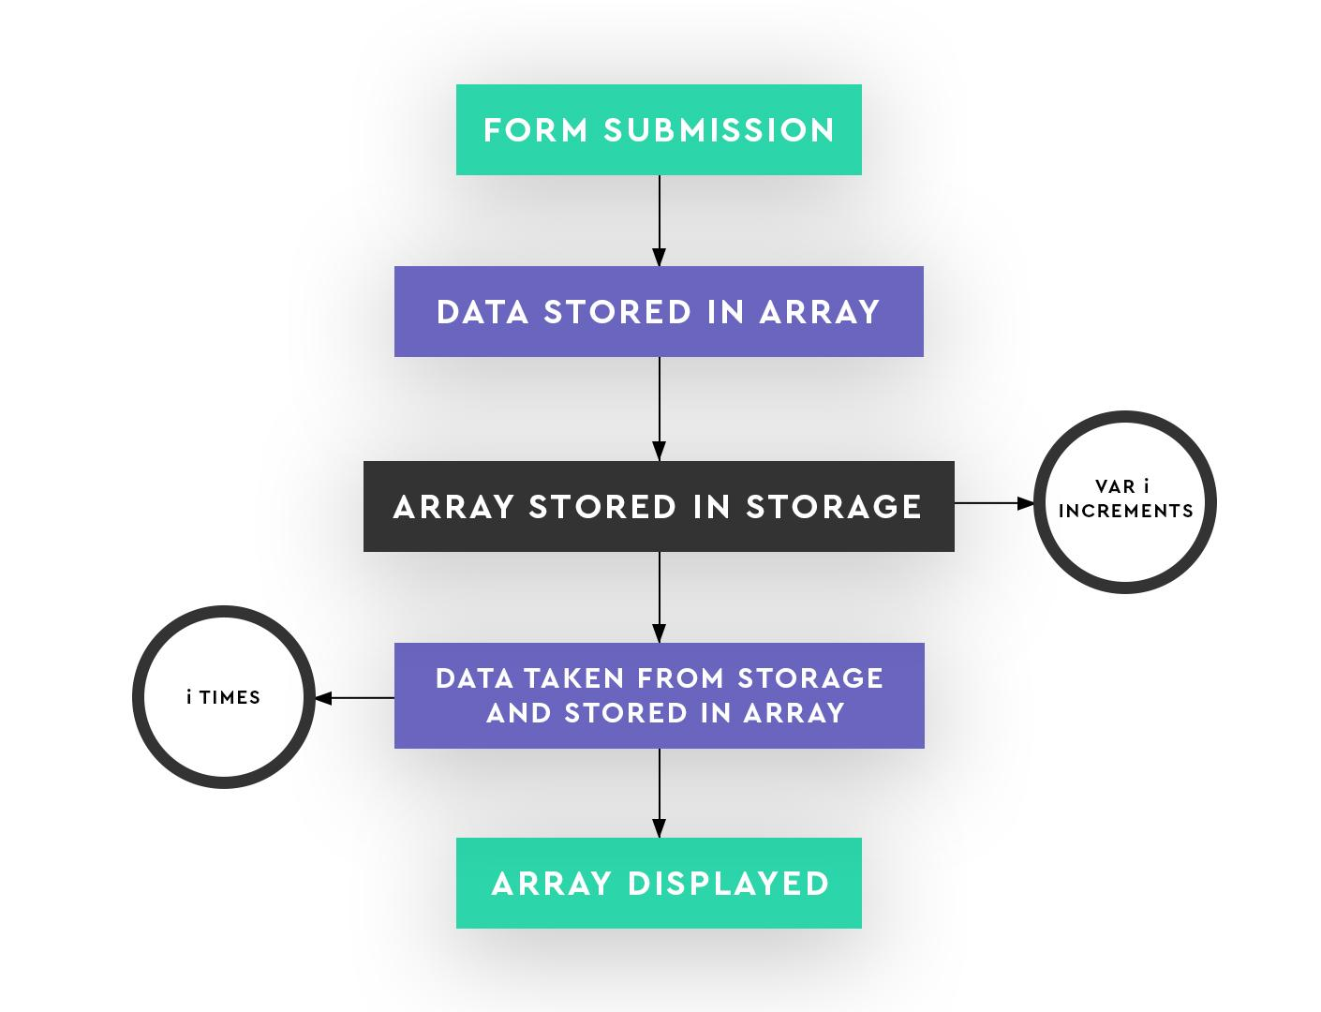
ARCHITECTURE DIAGRAM

Slide 5
What’s Next
What we’ll do in the next 24 hours.
Establish a proper database and server for easy use.
Make login functionality for teachers and faculty to view feedbacks

Slide 6
Thank You!!

